Slide 1

Phone Data set
Phone data set based on prices, brands, specifications, and price distribution across different brands

Slide 2

DataSet
This dataset comprises phone features and prices of popular brands, with every phone. It includes attributes such as phone name, brand, operating system, screen size and resolution, battery capacity and type, RAM, announcement date, weight, storage capacity, and various camera features like 720p, 1080p, 4K, and 8K video capabilities at different frame rates. Finally, it also provides the price of each phone in USD.

Slide 3
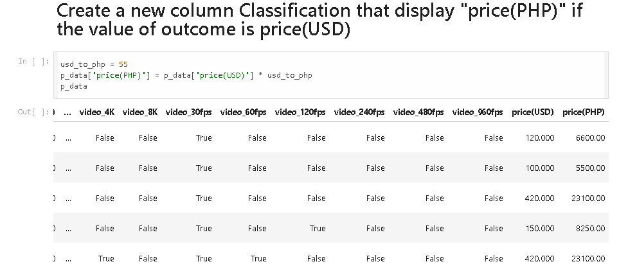
PRICE
Adding a new column where we multiplied the amount of usd to the conversion of usd to php to have a column of ph prices

Slide 4
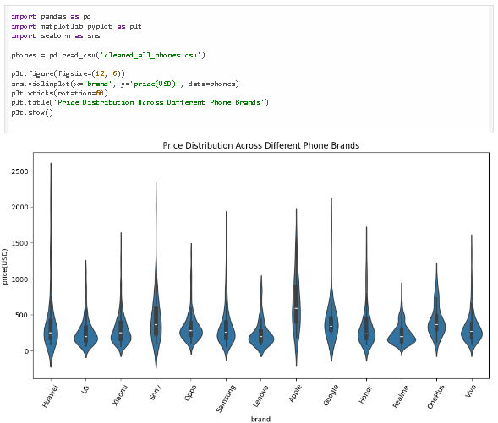
Violin Graph
Used a violin plot graph, imported a matplotlib and also seaborn to make the violin plot work..
Price distribution across different phone brands, we will able to analyze what brand have the most increase in its price

Slide 5
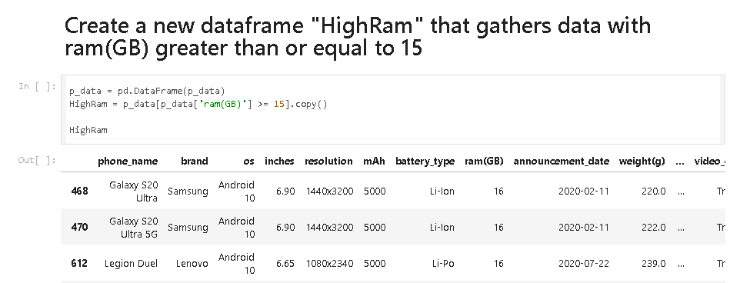
DataFrame
Creating a HighRam DataFrame to be able to specify which phones have ram that exceeds or equal to 15

Slide 6
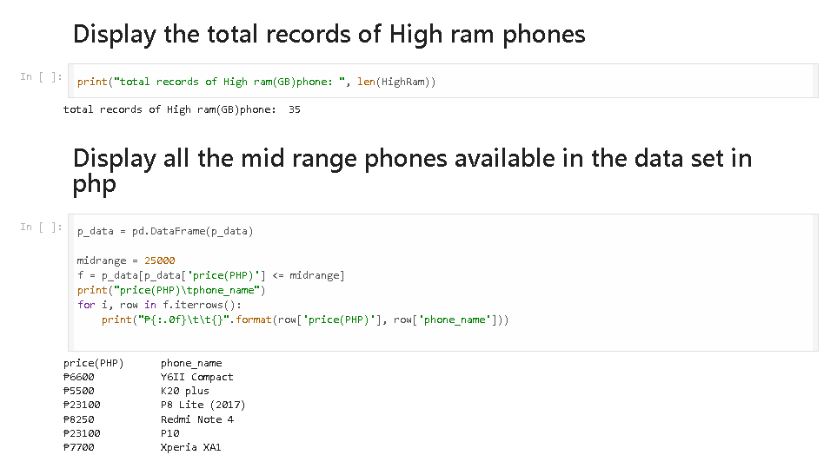
Displaying the total high ram and mid range phones prices.

Slide 7
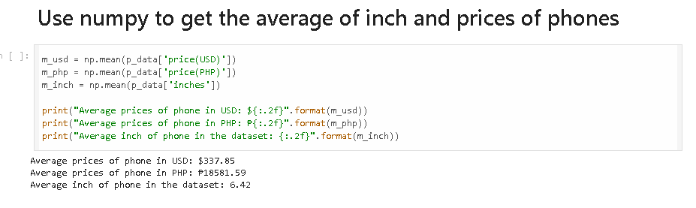
Mean

Slide 8
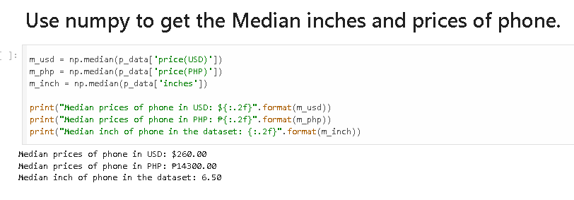
Median

Slide 9
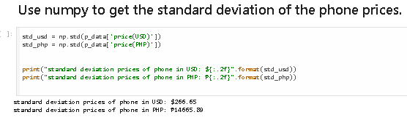
STANDARD
DEVIATION

